Slide 1

ANNAMACHARYA INSTITUTE OF TECHNOLOGY AND SCIENCES::TIRUPATI (AUTONOMOUS) Artificial Intelligence & Data Science A.Y.: 2025-2026 ABSTRACT REVIEW A Text-to-Image Generators in the Development of the Usability Interface
Under the Guidance of
Ms .K .Gangothri , MCA
Associate Professor
Department of AI&DS
AITS, Tirupati
Head of the Department
Ms. B. Rupa Devi Singh, M.Tech., (Ph.D) Associate Professor
Department of AI&DS
AITS, Tirupati
BATCH NO: 11
22AK1A3057 NARAYANA VARA PRASAD REDDY Y
22AK1A3065 PRABHAS V
22AK1A3074 SALEEM BASHA SHAIK
22AK1A3092 VENKATA ASHISH RAJ K

Slide 2
This study presents the implementation of a text-to-image generation system that converts natural language descriptions into corresponding visual outputs using deep learning–based generative models. The study focuses on understanding how textual prompts are processed and mapped to image features for meaningful image synthesis. Modern generative techniques are employed to learn semantic relationships between text and images and to produce diverse visual results. A minimal interface is used only to demonstrate the generation process and visualize outputs. The proposed system aims to make text-to-image generation easier to understand for academic learning and experimentation. The approach highlights the capabilities and limitations of generative models in practical applications.
ABSTRACT

Slide 3
Title Relevance and Justification
The title clearly explains that the project is about generating images from text.
It shows that the system is used for improving usability interfaces.
The title reflects the use of modern Artificial Intelligence technology. It tells what the project does in a simple and meaningful way.
It tells what the project does in a simple and meaningful way.
It matches the goal of creating images automatically using text input.

Slide 4
Problem Statement and Research Motivation
Problem Statement:
Creating images manually takes a lot of time and requires design skills. As the need for images increases, it becomes difficult to create them quickly and consistently. Existing image generation methods often need large datasets and expert knowledge, which are not easily available. Therefore, there is a need for a system that can generate images automatically from text descriptions in a simple and efficient way.
Motivation:
There is a growing need for images in websites and applications
Manual image design is time-consuming and costly
Not everyone has design skills
Text-to-image technology makes image creation easy
This motivated us to develop an automatic image generation system

Slide 5
Abstract Structure and Clarity
Background : Explains the importance of generating images for modern user interfaces.
Objective : Describes the goal of converting text into images.
Methodology : Tells how text prompts are used with AI models to create images.
Results : Shows how well the system generates useful and quality images.

Slide 6
Methodology Overview
The user gives a text description of the required image.
The system uses a text-to-image model (Stable Diffusion) to process the input.
The model generates an image based on the given text.
The generated image is displayed on the web interface.
The output is checked for quality and usefulness.

Slide 7
Originality and Novel Contribution
This project uses text-to-image generation to create UI images automatically.
It applies Stable Diffusion for generating images based on user text input.
It reduces the need for manual image design in usability interfaces.
It allows users to generate different styles of images using simple text prompts.
The system shows a practical use of AI in web and UI development.

Slide 8
Results, Outcomes, and Implications
The system successfully generated images from text descriptions.
The generated images matched the given text prompts.
The UI images were clear and visually consistent.
The time and effort needed for manual image design was reduced.
The image generation time varies based on system performance and input complexity
The project shows that text-to-image technology can improve UI development.

Slide 9
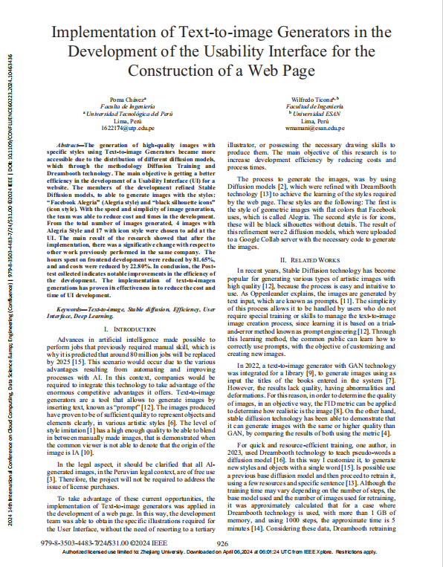
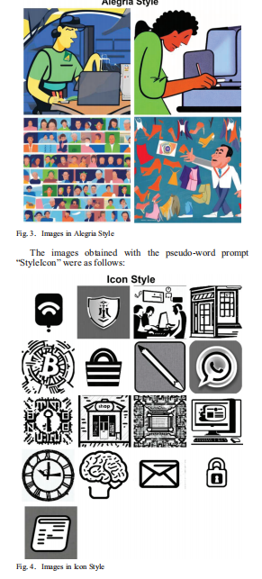

Slide 10
REFERENCES
P. Dhariwal and A. Nichol, Diffusion Models Beat GANs on Image Synthesis,” Advances in Neural Information Processing Systems (NeurIPS), vol. 34, pp. 8780–8794, 2021.
J .Oppenlaender ., Proceedings of the ACM Conference on Creativity and Cognition, 2022.
P. Chavez, W. Mamani, and S. Lee., Implementation of Text-to-Image Generators in the Development of the Usability Interface for the Construction of a Web Page,”

Slide 11
Thank You

